Slide 1
Cloud computing fundamental for Azure

Slide 2
Hardware
Computer hardware refers to a system's physical components, including the processor, memory, storage, input/output, and other peripherals. The purpose of computer hardware is to provide a platform for running software applications that allow users to perform various tasks efficiently.
Key: Touch and feel

Slide 3
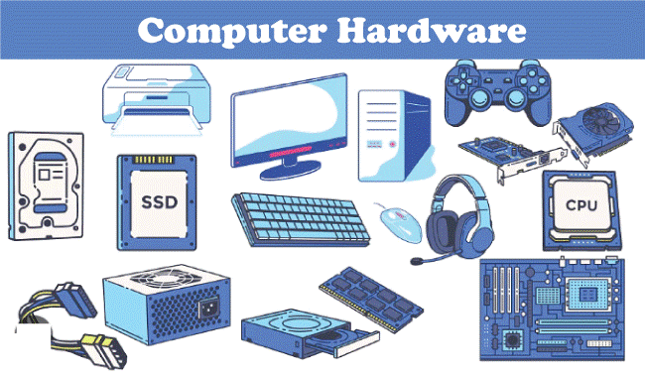
Hardware

Slide 4
Software
A set of instructions that directs a computer’s hardware to perform a task is called a program, or software program.

Slide 5
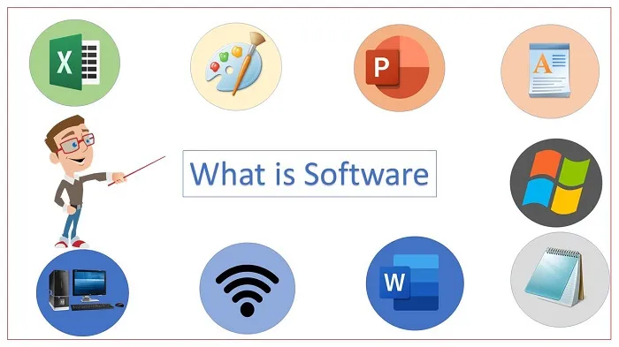
Software

Slide 6
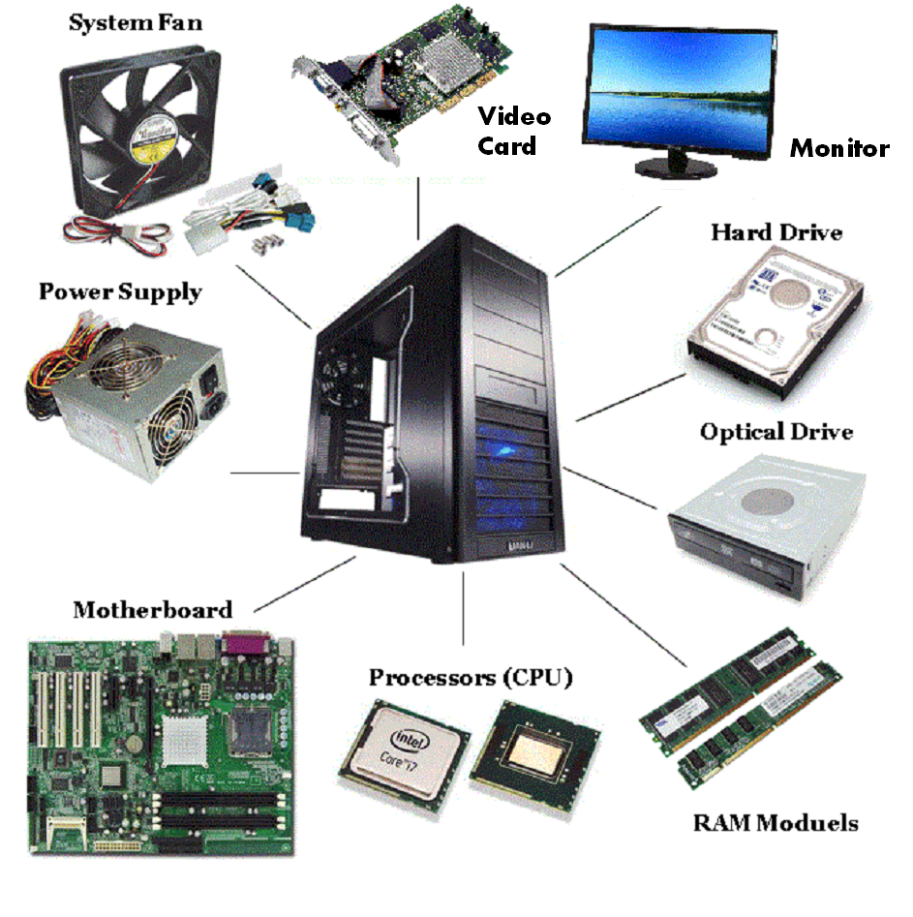
Deep Drive into Hardware

Slide 7
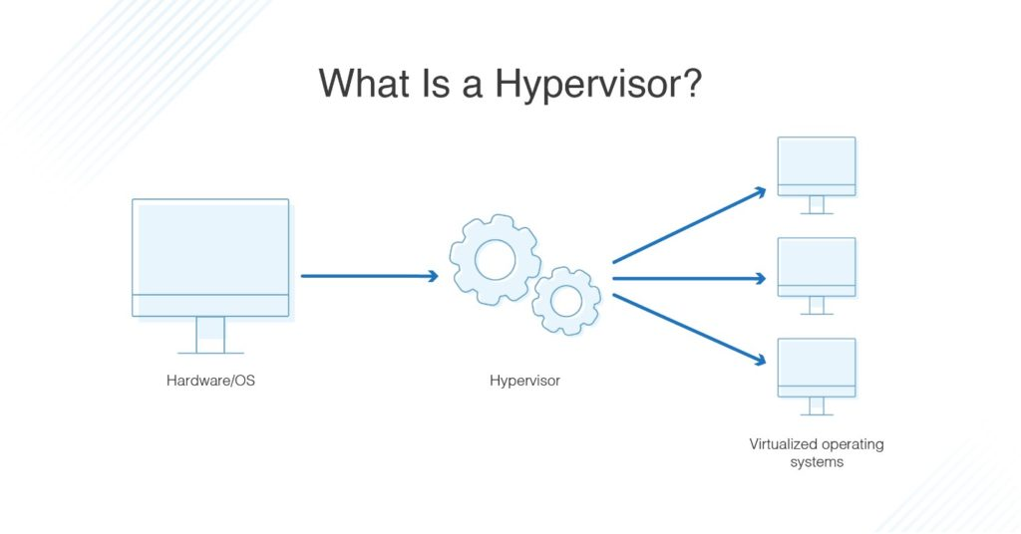
Hypervisor

